Slide 1


Oral Communication Skills B
(CELEN082)
Lesson 3.1

Slide 2
Lesson aims and objectives
Increase your awareness of the content and signposting language that can be included when presenting visual data. Practise using intonation to express your meaning more clearly. Practise presenting visual data effectively and accurately to support claims.

Slide 3

Getting started

Slide 4
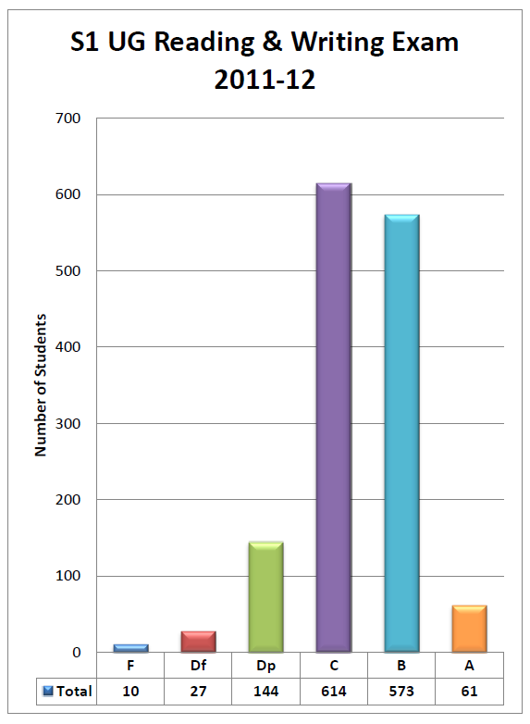
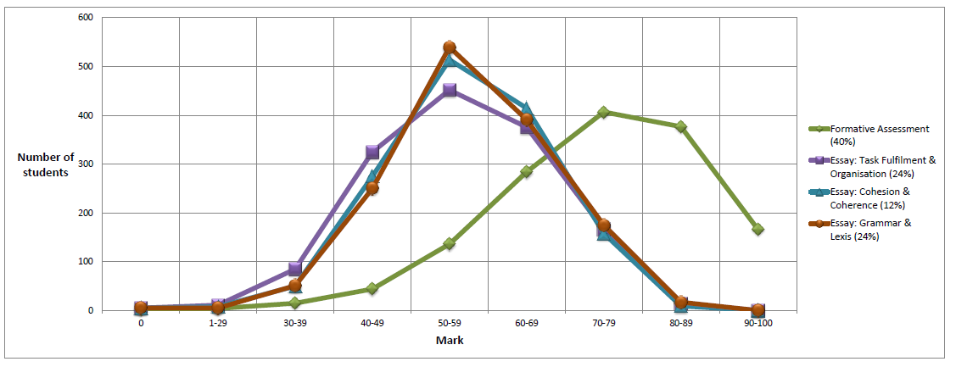
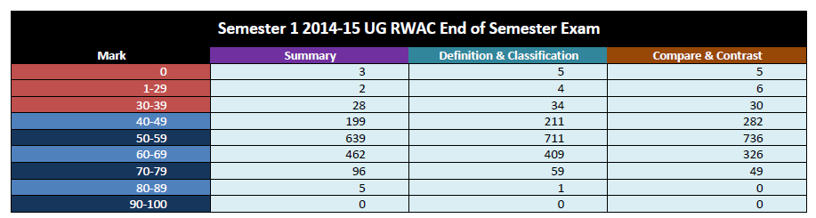
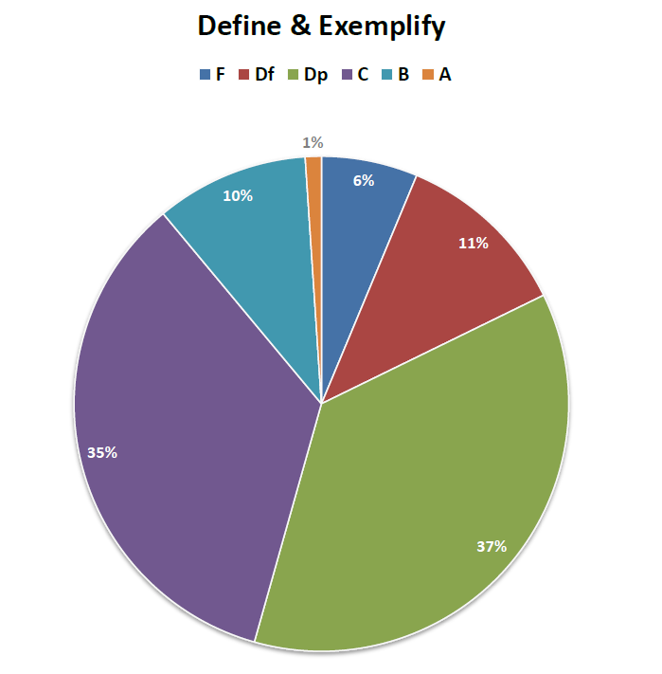
Getting started: Introduction to visual data
Experienced presenters often use visual data to support their claims.
Name the types of visual data below.
List at least two reasons why it might be useful to use visual data in your presentation.

Slide 5

Getting started: Introduction to visual data
List at least two reasons why it is often useful to use visual data in presentations.
It is often easier to understand complex data when it is presented in a visual form.
It makes complex data more memorable.
It looks professional and shows that you are well-prepared.
It provides variety in your presentation.

Slide 6
Getting started: Key language
Match each sentence below to the trend it best describes.
The company saw significant fluctuations in sales.
The company experienced a significant increase in sales.
The company's sales remained relatively stable.
The company's sales fell dramatically.
4
1
A
B
C
D
2
3
Make at least one more sentence to describe each trend.

Slide 7
Getting started: Key language
Match each sentence below to the trend it best describes.
The obesity rate in the UK in 2022 was significantly higher than in France.
The obesity rate in France in 2022 was slightly lower than in Italy.
Romania had the highest obesity rate amongst all European countries in 2022.
Germany and Denmark had similar obesity rates in 2022.
2
3
1
4
A
B
C
D
Make at least one more sentence to describe each trend.
Notes:
https://www-statista-com.ezproxy.nottingham.edu.cn/statistics/1276194/overweight-and-obesity-rate-in-europe/

Slide 8
Getting started: Supporting a claim with visual data
Work with your partner to practise using the visual data provided to support a claim about obesity in the UK. You have 10 minutes to prepare. Then, you will present to another student.
STUDENT A
“And, in the UK, obesity has become a real problem because, over the last 20 years, it’s become increasingly prevalent.”
STUDENT B
“One of the major contributors to the rise in obesity in the UK is the consumption of too much sugar.”

Slide 9
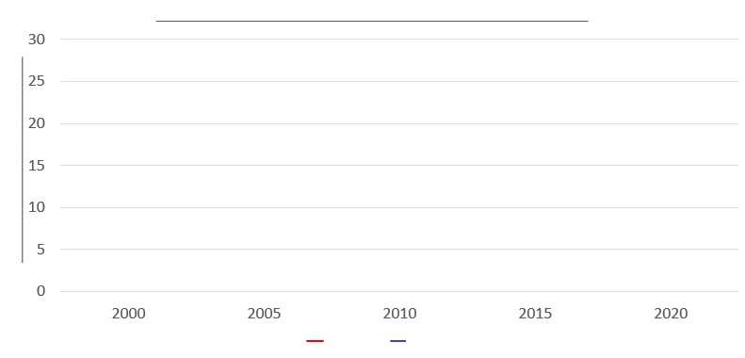
Getting started: Supporting a claim with visual data
Student A:
Describe the visual data to support your claim about obesity in the UK.
Student B:
Listen to Student A’s description. Add the important information described to your template to recreate the visual data.
Don’t show each other your visual data!
Once you finish, switch roles.
“And, in the UK, obesity has become a real problem because, over the last 20 years, it’s become increasingly prevalent.”

Slide 10
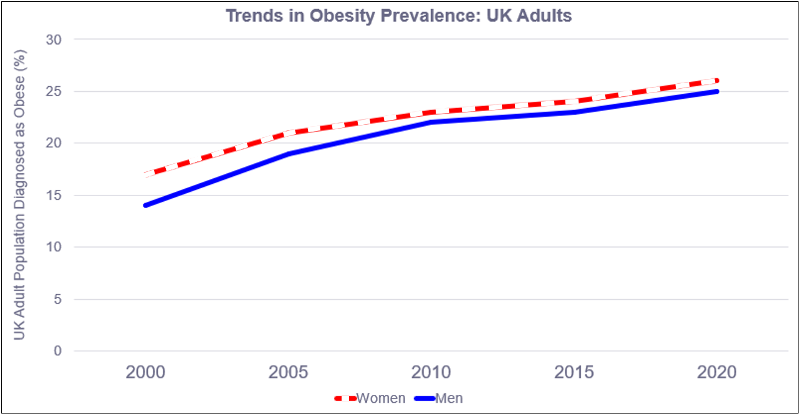
STUDENT B
Does your line graph look like this?
It may not be necessary to have all the data.
(WHO, 2021)

Slide 11
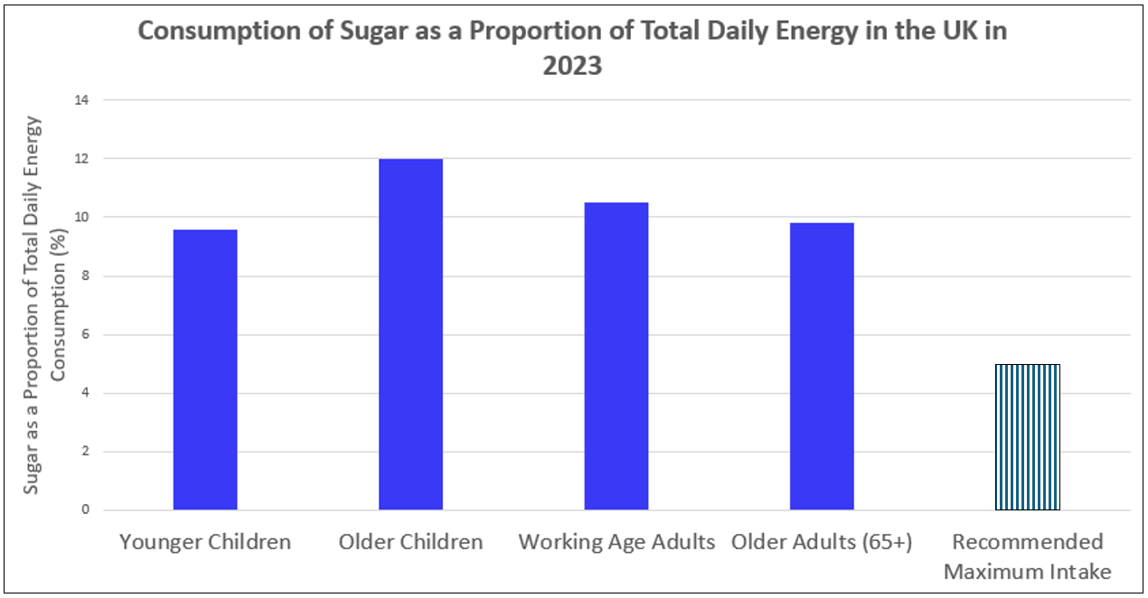
STUDENT A
Does your bar chart look like this?
It may not be necessary to have all the data.
(Public Health England, 2023)

Slide 12
Presenting visual data

Slide 13

Presenting visual data
Listen to an experienced speaker present the visual data about obesity in the UK and identify the information given and its order (write 1-5 accordingly).
The speaker … | Order
explains what the visual data shows
highlights the key data
makes a claim | 1
comments to emphasize how the data supports the claim
signposts the introduction of visual data

Slide 14
Presenting visual data
And, in the UK over the last 20 years, [obesity] has become increasingly prevalent.
Makes a claim
Signposts the introduction of visual data
Let me tell you some statistics demonstrating this.
This graph, from the WHO, shows trends in obesity among adults in Britain between 2000 and 2020. The vertical represents the percentage of the UK adult population diagnosed as being obese and the two lines represent gender. The purple line represents women and the blue line illustrates men.
Explains what the visual data shows
You can know that, for both sexes, levels of obesity have fallen by around 10% over the past twenty years. The result of this increase is that, now, approximately one third of the UK population is obese
Highlights the key data
Comments to emphasize how the data supports the claim
which, I think you’ll agree, is a problem.
Did you include all of these parts when you presented the visual data? If not, what didn’t you include?

Slide 15
Presenting visual data: The language
Watch the experienced speaker present the visual data again and listen for the key vocabulary / phrases. Pay attention to the 9 underlined sections of text. Each one contains a mistake (e.g. a missing, incorrect word). Listen and fix them.
And, in the UK over the last 20 years, [obesity] has become increasingly prevalent. Let me tell you (1) some statistics demonstrating this. This graph (2), from the WHO, shows trends in obesity among adults in Britain between 2000 and 2020. The vertical (3) represents the percentage of the UK adult population diagnosed as being obese and the two lines represent gender. The purple line represents women (4) and the blue line illustrates men (5). You can know that (6), for both sexes, levels of obesity have fallen (7) by around 10% over the past twenty years. The result of this increase is that, now, approximately one third (8) of the UK population is obese which, I think you’ll agree, is a problem (9).

Slide 16
Presenting visual data: The language
And, in the UK over the last 20 years, [obesity] has become increasingly prevalent. Let me show you (1) some statistics demonstrating this. This line graph (2), from the WHO, shows trends in obesity among adults in Britain between 2000 and 2020. The vertical axis (3) represents the percentage of the UK adult population diagnosed as being obese and the two lines represent gender. The red line represents women (4) and the blue line represents men (5). You can see that (6), for both sexes, levels of obesity have increased (7) by around 10% over the past twenty years. The result of this increase is that, now, approximately one quarter (8) of the UK population is obese which, I think you’ll agree, is a significant problem (9).
Did you use similar signposting phrases and vocabulary when you presented?

Slide 17
Intonation

Slide 18
Intonation: Introduction to tones
One of the key skills that effective public speakers use is ‘intonation’. They can raise, lower or keep flat the tone of their voice to:
show their attitude towards the ideas they are presenting.
help the audience follow the meaning and structure of presentations.
Analyse four extracts from the sample presentation. At the end of each line predict which tone the speaker might use: ,  or →.

Slide 19

1 | 2
in the uK obesity has become a REAL problem because over the LAST TWENty years it’s become inCREAsingly PREvalent | the RED line represents WOmen and the BLUE line represents MEN
3 | 4
oKAY so HOW eFFECtive would this solution BE? WELL this solution would be GREAT | We’d need to create the reSOURces create the WEBsite and then PUblicize the camPAIGN.


→
→
→










Slide 20
Intonation: Intonation Patterns
Analyse the four extracts again and find at least one example of each intonation pattern that:
(a) emphasises contrasting information.
(b) indicates the speaker has not finished an idea yet.
(c) indicates the speaker has finished an idea.
(d) shows the speaker’s emotional attitude towards an idea.
(e) emphasises the speaker is listing similar ideas.
(f) is used for rhetorical questions.

Slide 21
Intonation: Intonation Patterns
1
in the uK obesity has become a REAL problem because over the LAST TWENty years it’s become inCREAsingly PREvalent

The speaker uses  and → tones to indicate that he has not finished his idea yet.
→
→

The speaker uses a  tone at the end of the idea to indicate that he has now finished this idea.

Slide 22
Intonation: Intonation Patterns
2
the RED line represents WOmen and the BLUE line represents MEN
The speaker is contrasting women and men. The speaker uses a  tone on women (the 1st item of contrast) and a  tone on men (the 2nd item of contrast) to emphasise this contrast.

→

The speaker uses a → tone to indicate that he has not finished his idea yet.

Slide 23
Intonation: Intonation Patterns
3
oKAY so HOW eFFECtive would this solution BE? WELL this solution would be GREAT

The speaker uses  tones to indicate that he has not finished his idea yet.

The speaker uses a  tone for the rhetorical question.

The speaker uses a  tone to show that he has a positive emotional attitude towards this idea.
Change the word ‘great’ for ‘terrible’. How does the intonation change?


Slide 24
Intonation: Intonation Patterns
4
We’d need to create the reSOURces create the WEBsite and then PUblicize the camPAIGN.

The speaker uses  tones to indicate that he is listing similar items. The speaker uses a  tone on the final list item to show the list has now finished.



Slide 25
Individual practice

Slide 26
Practice
Look at the visual data you found for homework. Using what you have learnt, complete the following tasks:
Prepare to present this visual data to support a claim. Remember to include all the parts.
Think about how you could use ,  and → tones to communicate your meaning more clearly to the audience.
Your tutor may ask you to come to the front and present.

Slide 27
Homework
Due | Task
Lesson 3.2 | Draft your Research Poster. Bring it to class (on your computer or printed out). Watch the video entitled ‘How to Present an Academic Research Poster’ (link on Moodle) and take notes to answer the following questions: What are the purposes of poster presentations in: the academic world industry What tips does the speaker give for presenting posters?
Ongoing Self-Study
Start looking for information about potential solutions to your chosen problem:
What is the solution? How will you explain it?
How will you evaluate it?

